Slide 1

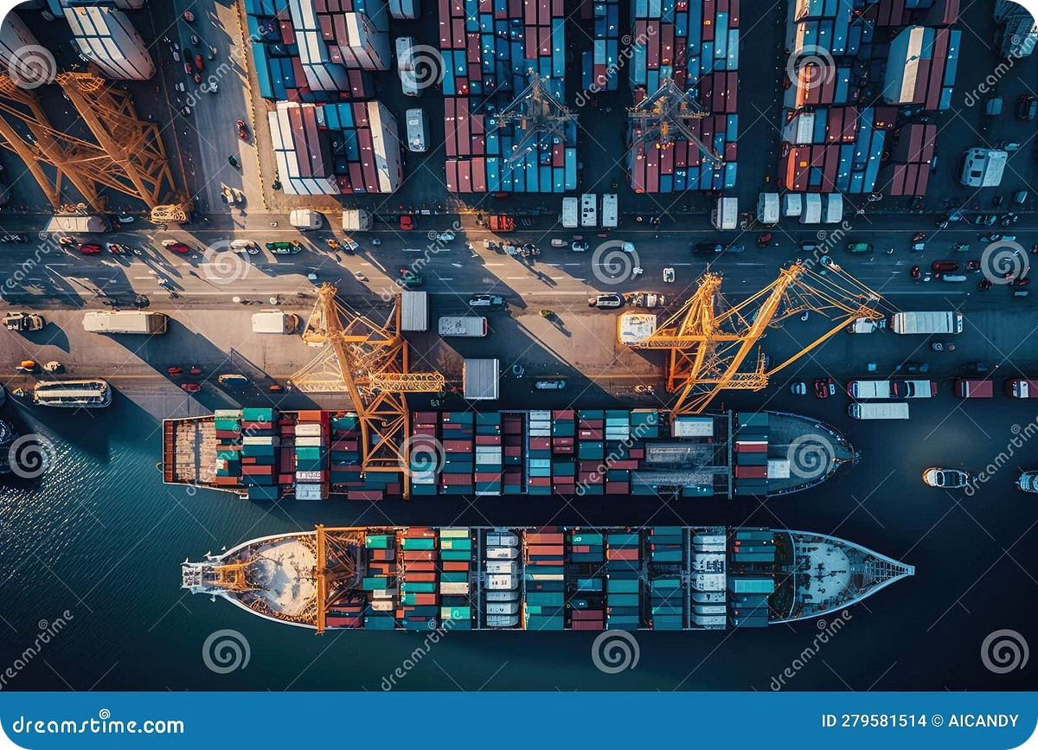
Transportation
Simplex
By-
Shivam Batra (L003)
Divyanshu Patil (L020)

Slide 2
Content
Title
Statement of problem
Data Description
Methodology
Data pre-processing
Implementation and Analysis
Results and Conclusion
References

Slide 3

Title
A transportation problem is a type of linear programming problem that focuses on finding the most cost-effective way to distribute products from multiple sources to multiple destinations.
The key components of transportation problem are:- Supply , Demand , Cost, supply and destination location.

Slide 4
Problem Statement
The company needs to decide how to allocate shipments to meet customer demand while minimizing the total cost. Design a business model for the above scenario using transportation dataset.

Slide 5
Data Description
The dataset contains the data of the orders placed by customers on a grocery delivery application. It includes the following columns:
Gender
Age
Category
Quantity
Selling price per unit of the product
Cost price per unit of the product
Payment_method
Region
State
Shopping_mall
.

Slide 6
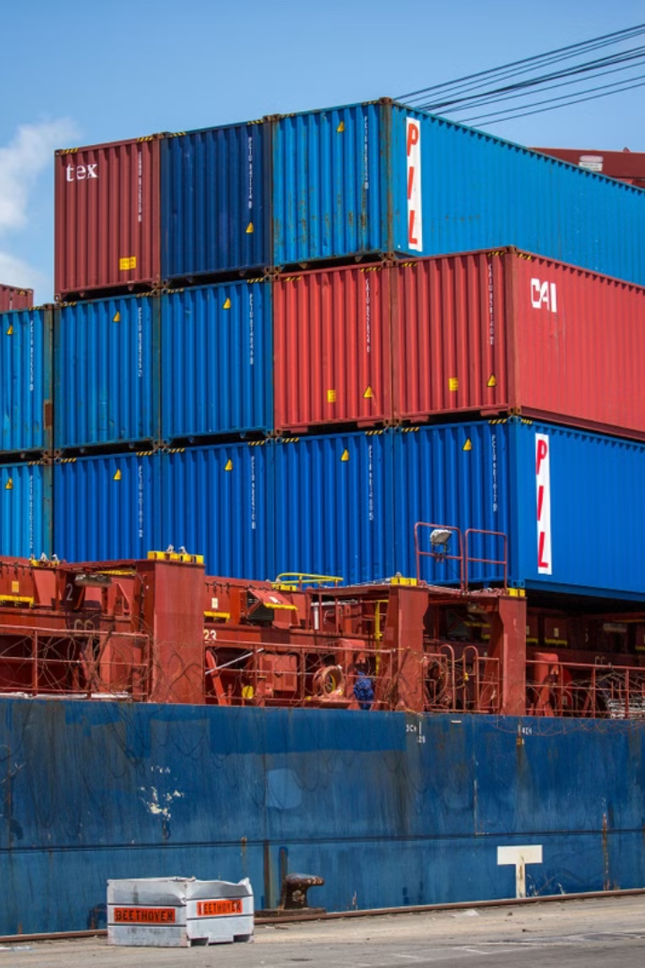
Methodology
Transporting items from a set of sources to a set of destinations
while taking into account the supply and demand at each location in order to optimize the overall cost of transportation is known as a transportation problem, which is a specific type of linear programming problem (LPP).
Three ways to solve the transportation problem:
North West Corner Method
Starting from the top left corner of the cost matrix
Least Cost Method
Allocating goods based on the lowest cost
Vogel Approximation Method
Find the penalties for each available row and column by taking the least cost and second least cost

Slide 7
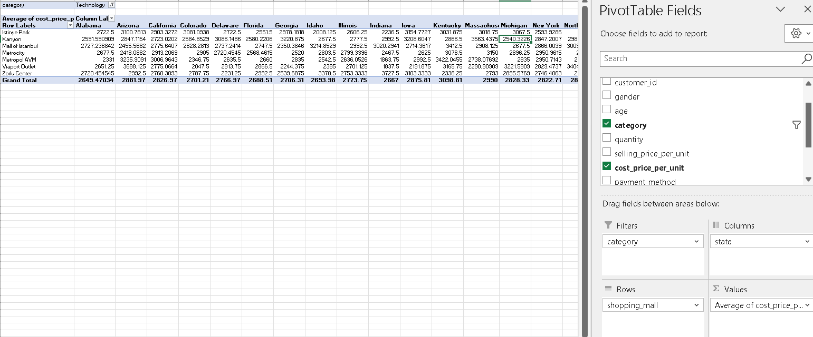
Data pre-processing

Slide 8
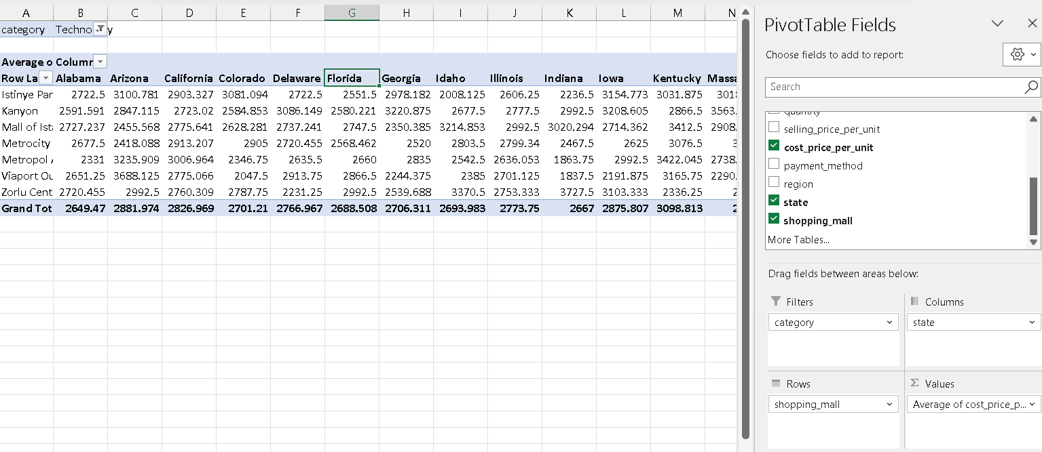
Data pre-processing

Slide 9
Data pre-processing
This is the final pivot table with both cost and quantity

Slide 10
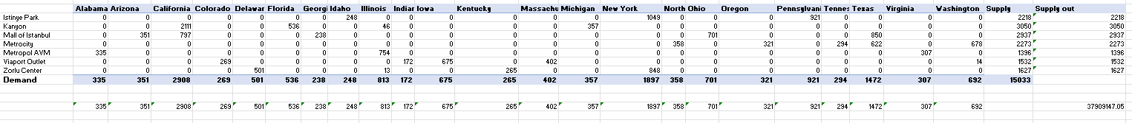
Implementation

Slide 11
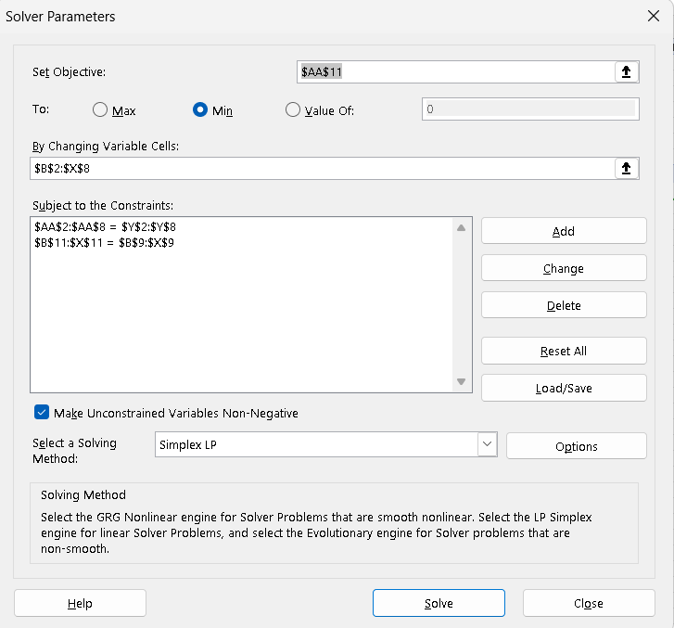
Implementation
Excel Solver

Slide 12
Analysis and Results
Minimum Cost for Transportation = USD 37,909,147.05

Slide 13
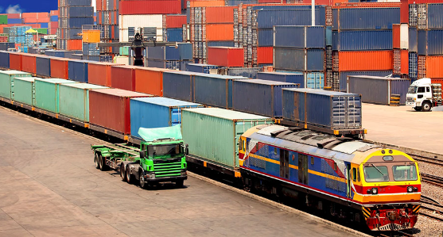
Conclusion
Informed Decision Making: Transportation Simplex helps the firm owner make informed decision with respect to cost and number of units.
Efficiency: Transportation simplex can also help the firm owner to plan out their strategy as it minimizes the cost.

Slide 14
References
https://www.kaggle.com/datasets/kzmontage/sales-from-different-stores
https://www.youtube.com/watch?v=k9iFrgWD-WY

Slide 15
Thank You

